Slide 1
21-cm meeting - Vivaldi and dual ridge horn antennas for REACHES
Nicolas Fagnoni – 03/06/2019
nf323@mrao.cam.ac.uk – University of Cambridge – Astrophysics Group

Slide 2
Summary
1. Problematic of a ground plane with a horn
2. Optimised 3.5-m large dual ridge horn with infinite top ground plane

Slide 3
Problematic of a ground plane with a horn

Slide 4
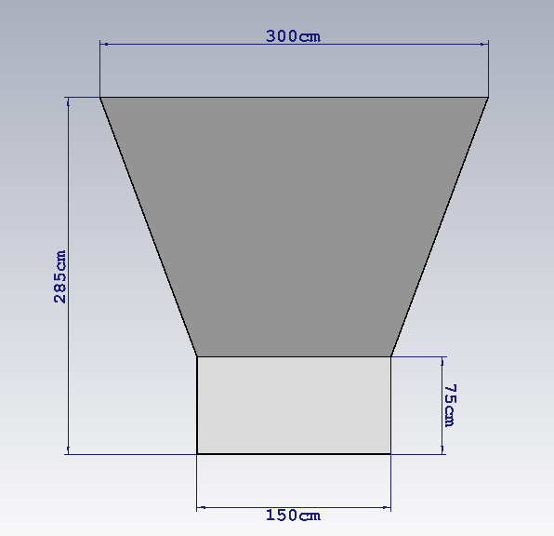
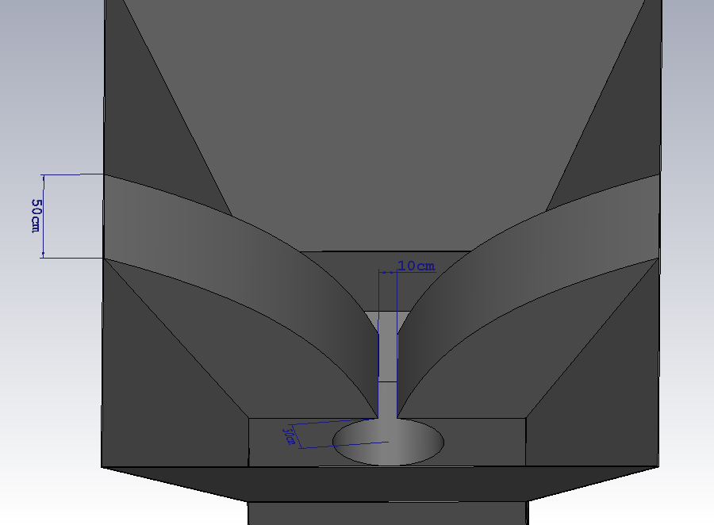
Antenna model (3-m large 2.85-m height)

Slide 5
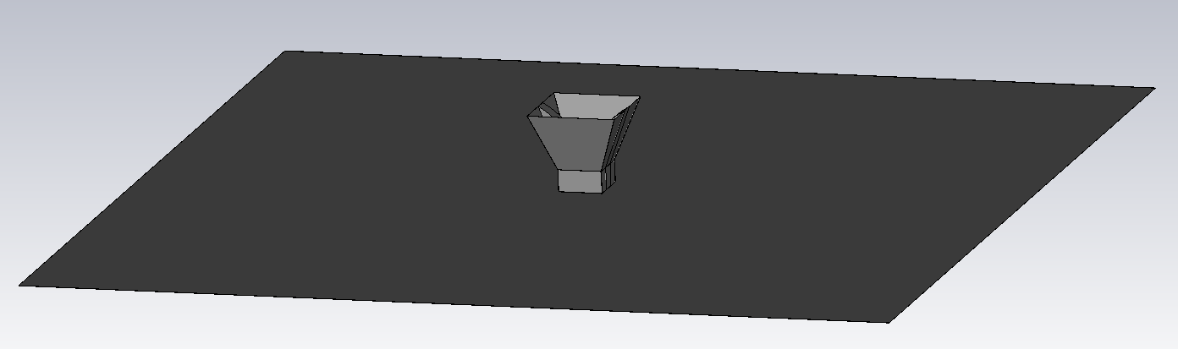
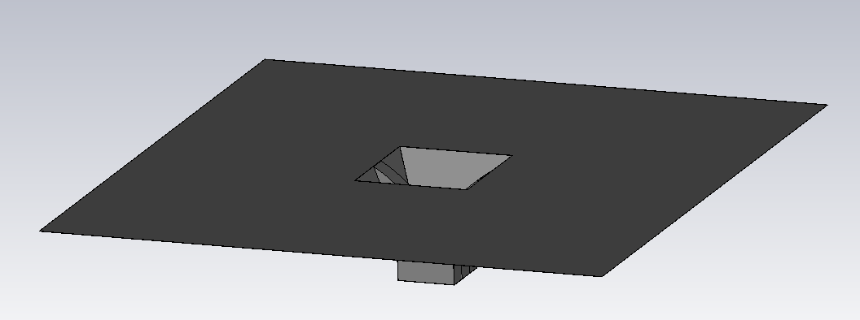
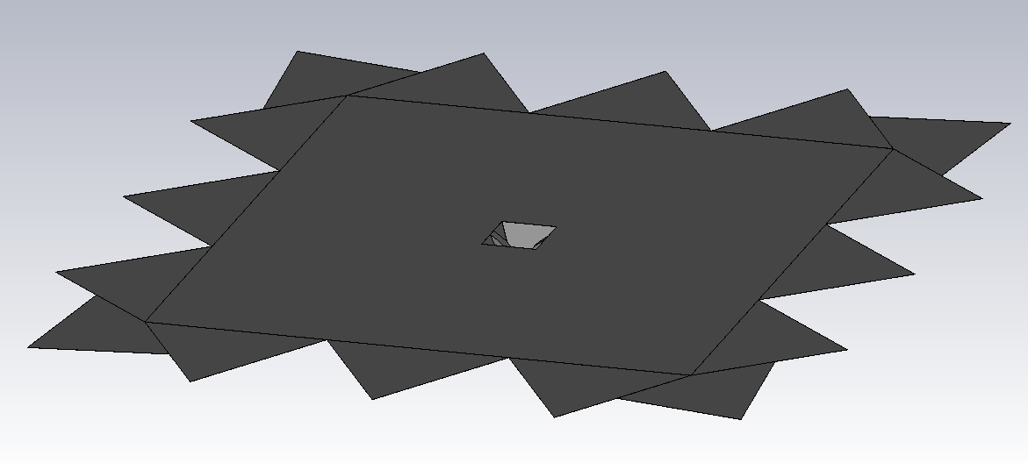
Ground plane models

Slide 6
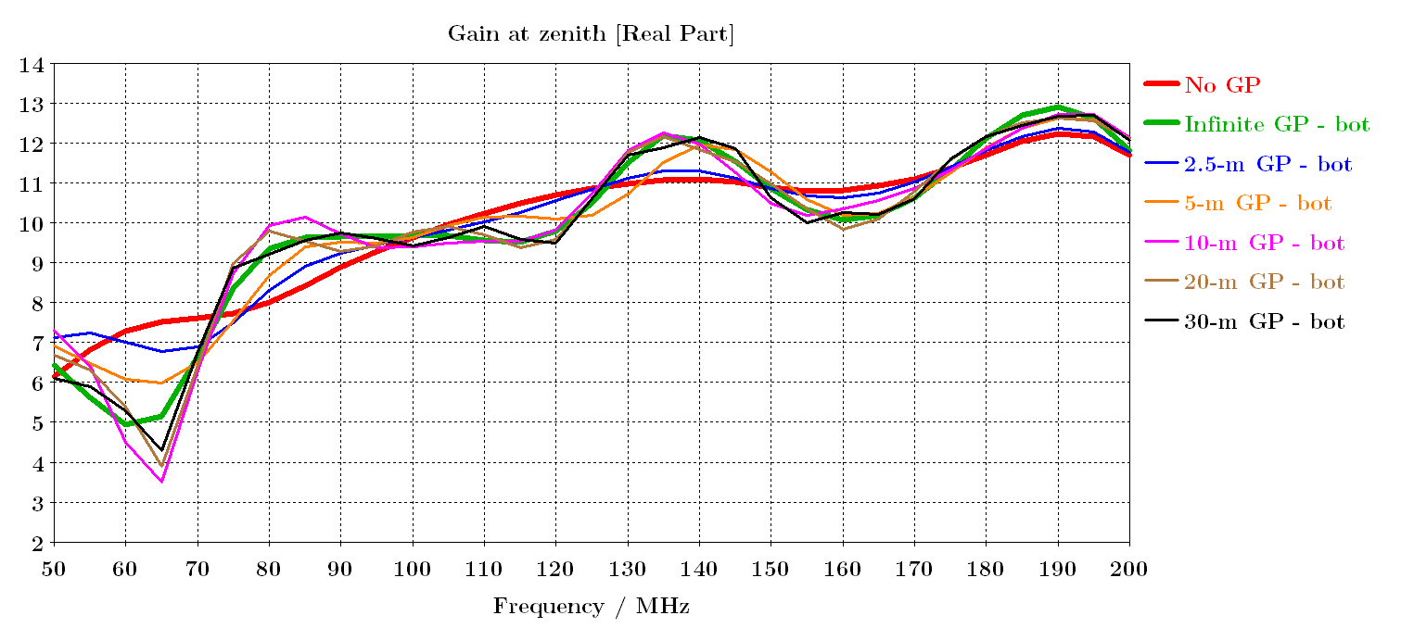
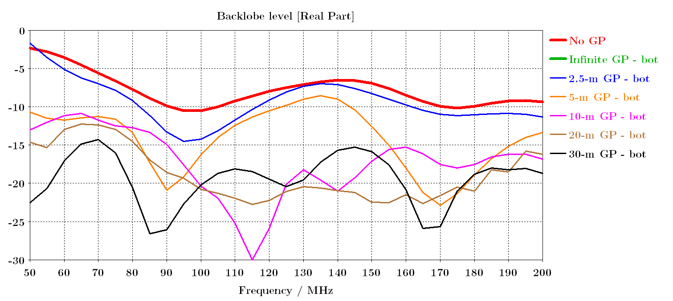
Effects of a ground plane BELOW the horn

Slide 7
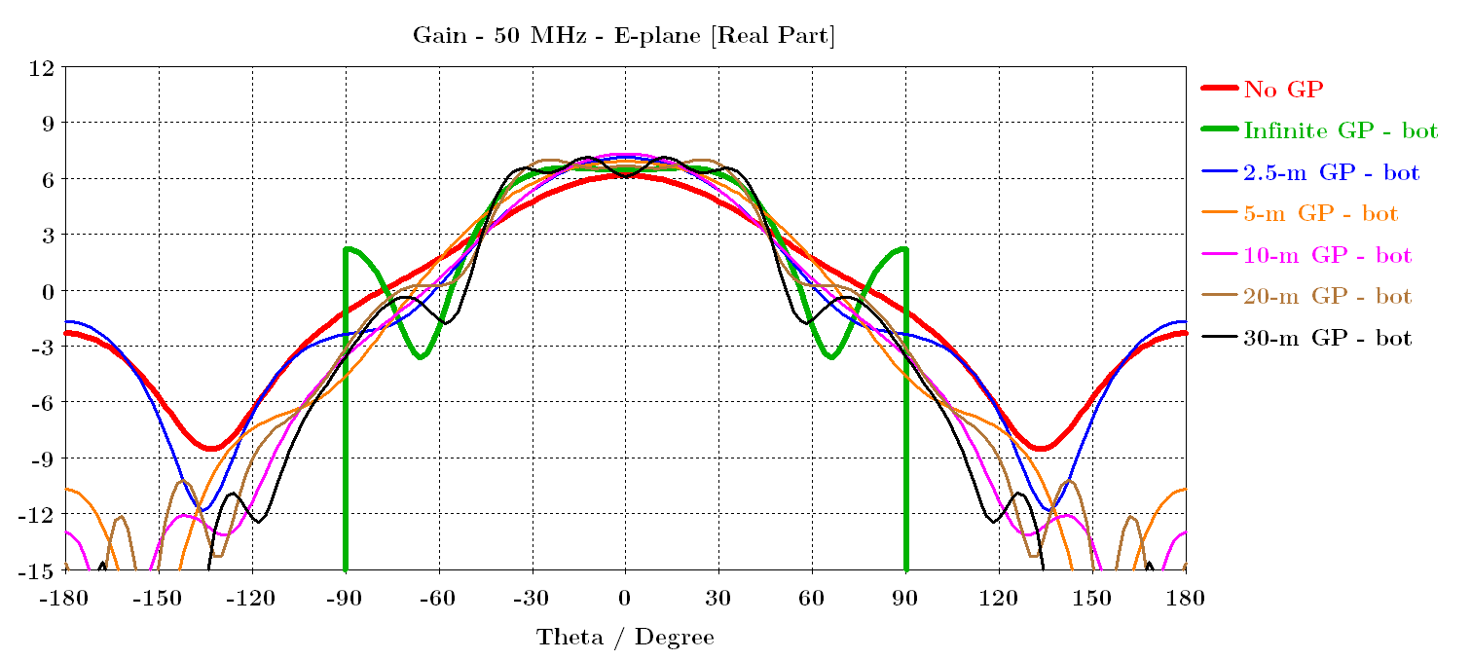
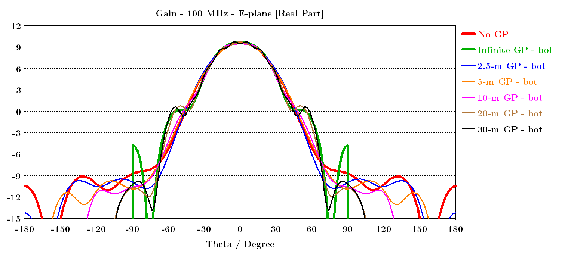
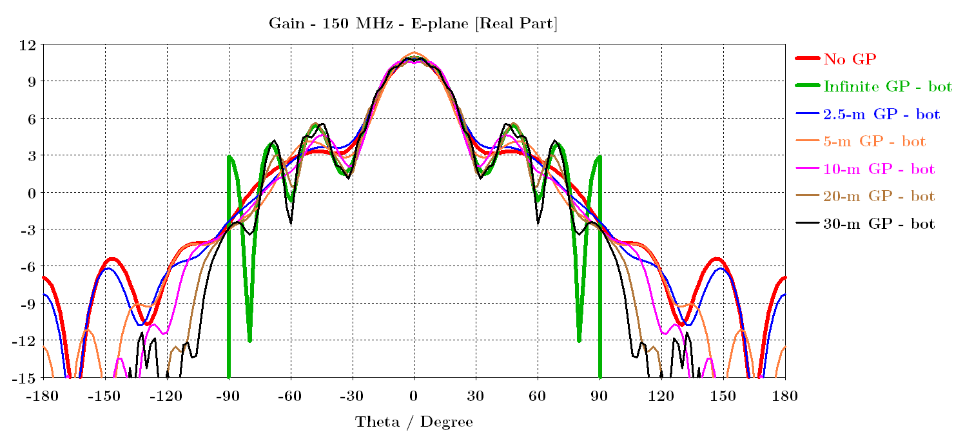
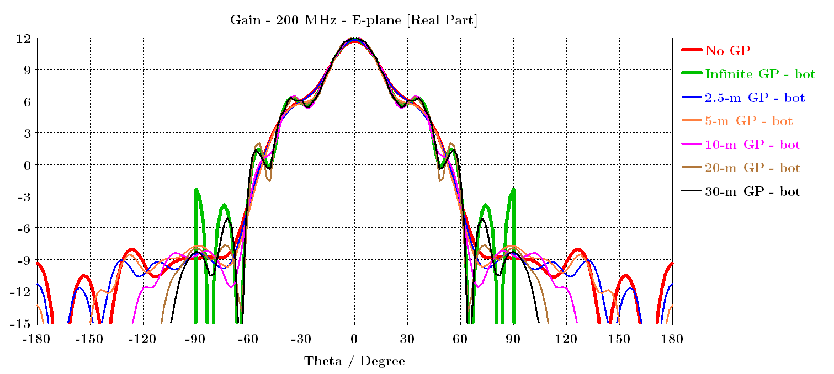
Effects of a ground plane BELOW the horn

Slide 8
Effects of a ground plane BELOW the horn
Conclusion:
Does not modify the antenna impedance
Necessary to reduce the backlobes
The larger the more effective it is to reduce the backlobe radiations
BUT increase the chromaticity of the beam
Trade-off: ~5 m (backlobes < -10 dB and gain/backlobe ratio > 20 dB)

Slide 9
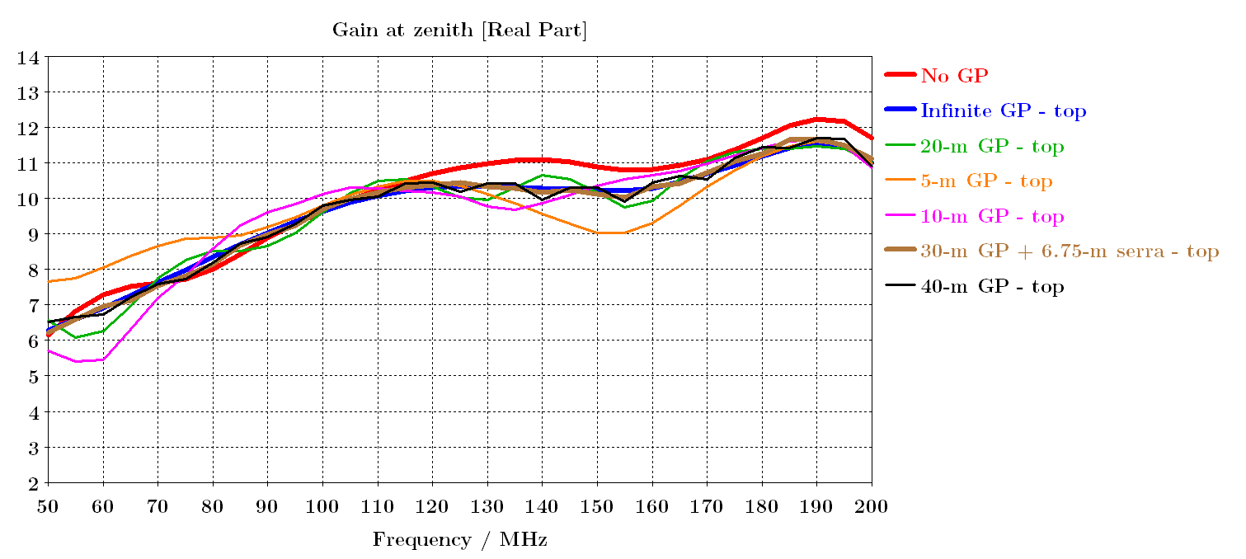
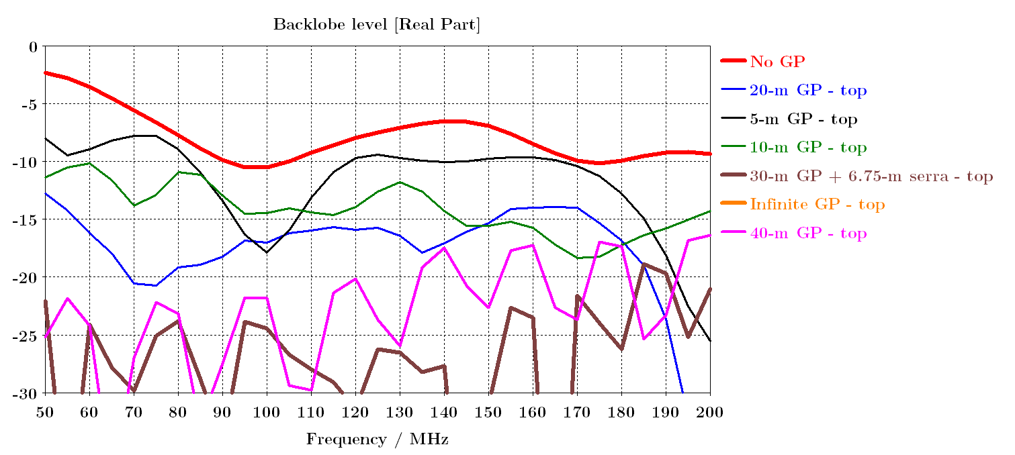
Effects of a ground plane ABOVE the horn

Slide 10
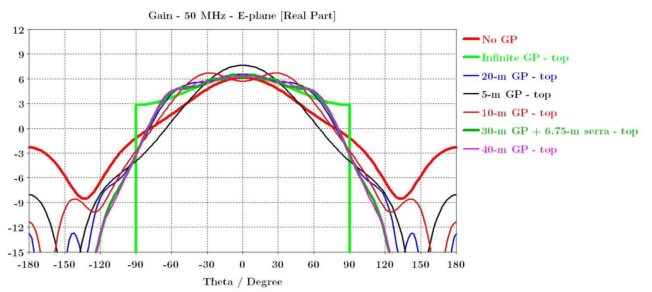
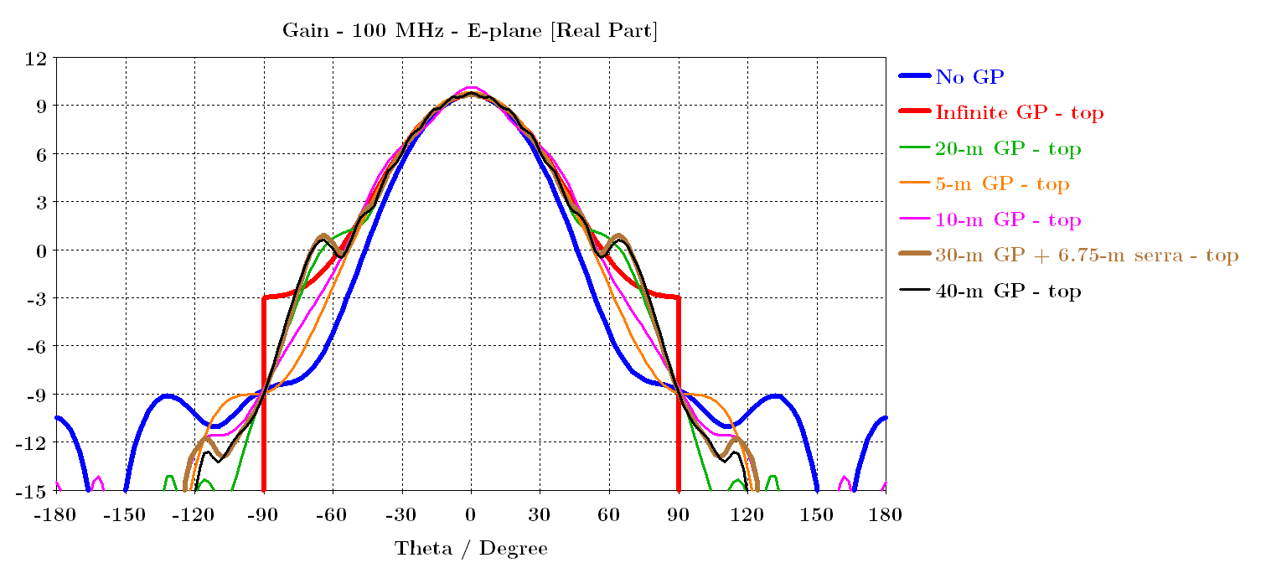
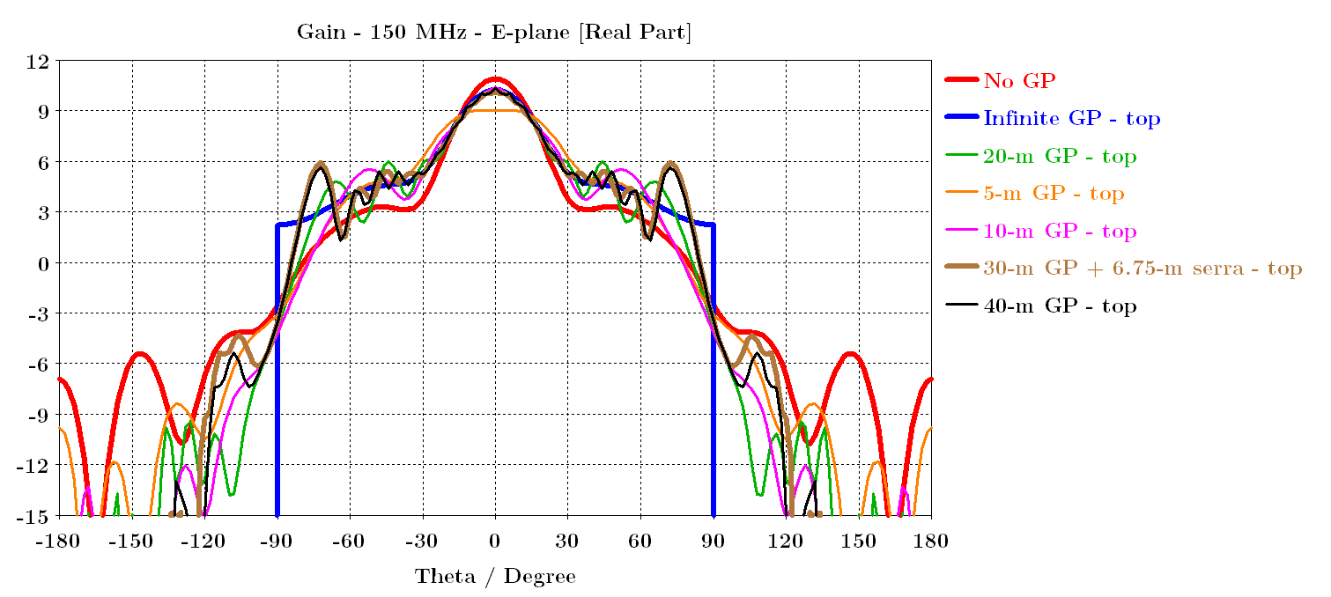
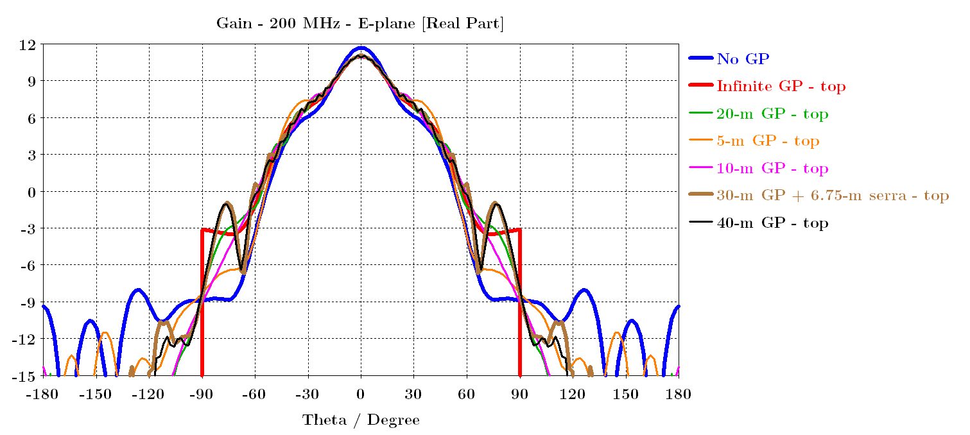
Effects of a ground plane BELOW the horn

Slide 11
Effects of a ground plane BELOW the horn
Conclusion:
Large ground plane + serration effective to reduce chromaticity caused by the ground plane

Slide 12
Optimised 3.5-m large dual ridge horn with and without ground plane

Slide 13
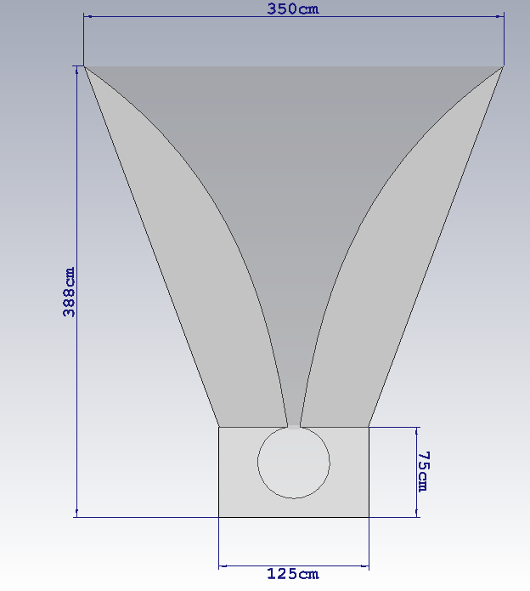
Models

Slide 14
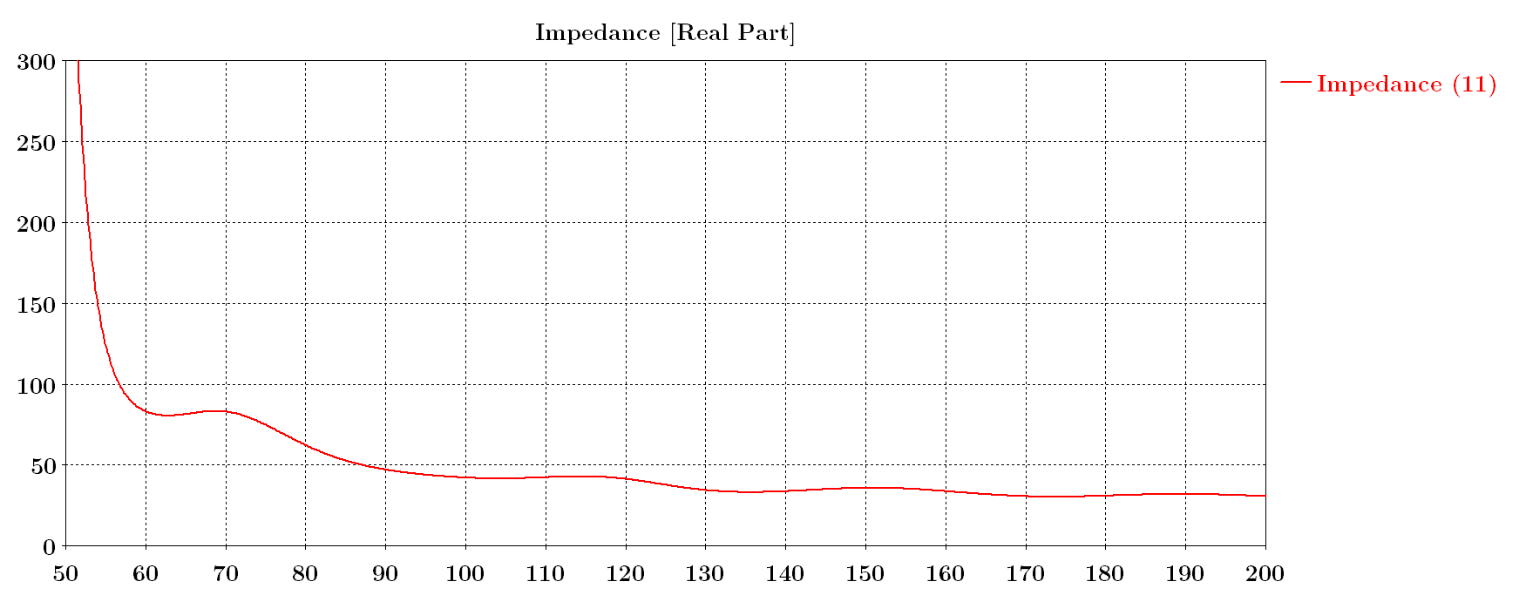
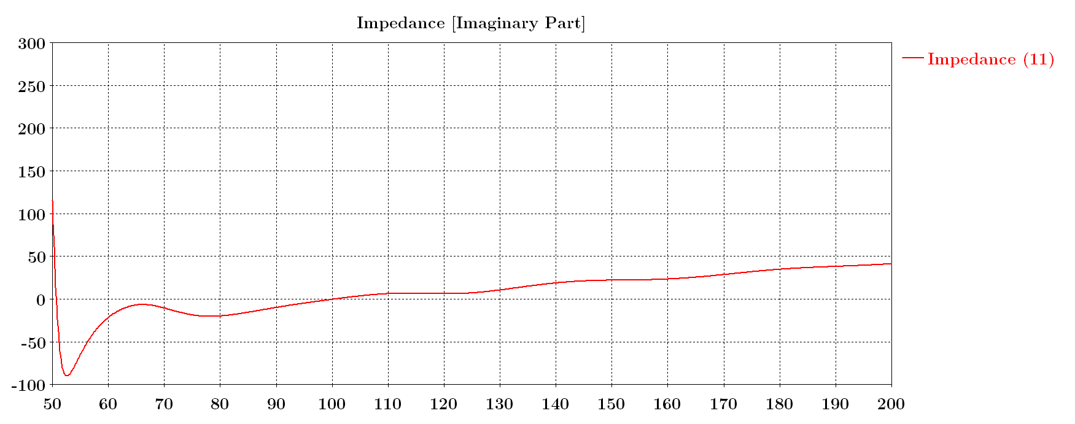
Antenna impedance

Slide 15
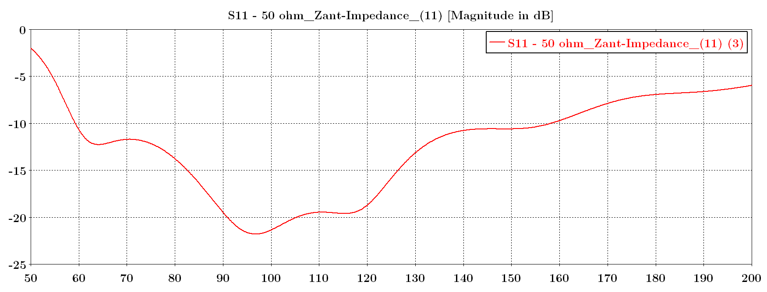
S11 – with respect to 50 ohm

Slide 16
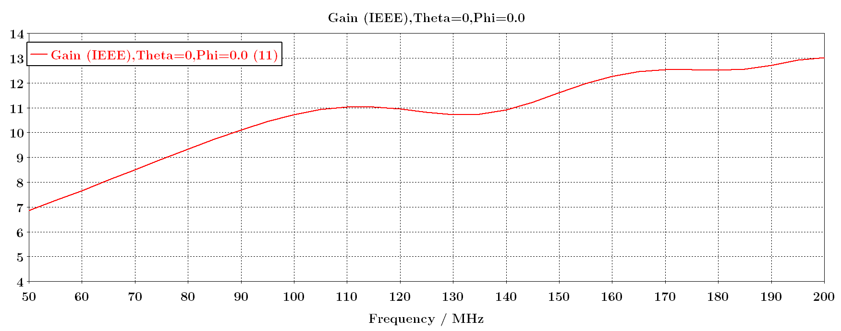
Gain

